Slide 1

ENHANCED FUEL DISPENSING AND DETERMININIG QUALITY OF FUEL
Presented by
Japathi Yashwanth Chandra - 100520735018
Ritvik Aggarwal - 100520735029
S Muhammed Farhan - 100520735030
Project guide :
Mr. R. Narender Reddy

Slide 2
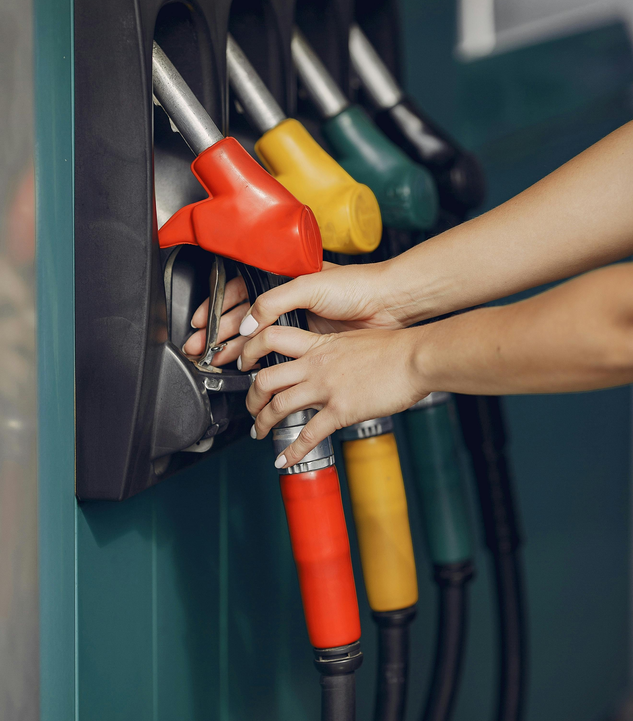
Table of Contents
Introduction
Problem statement
Objectives
Literature review
Existing system
Proposed System
Need For Alteration
Developed System
Observations and readings
Conclusion
Future Enhancements
Bibliography

Slide 3
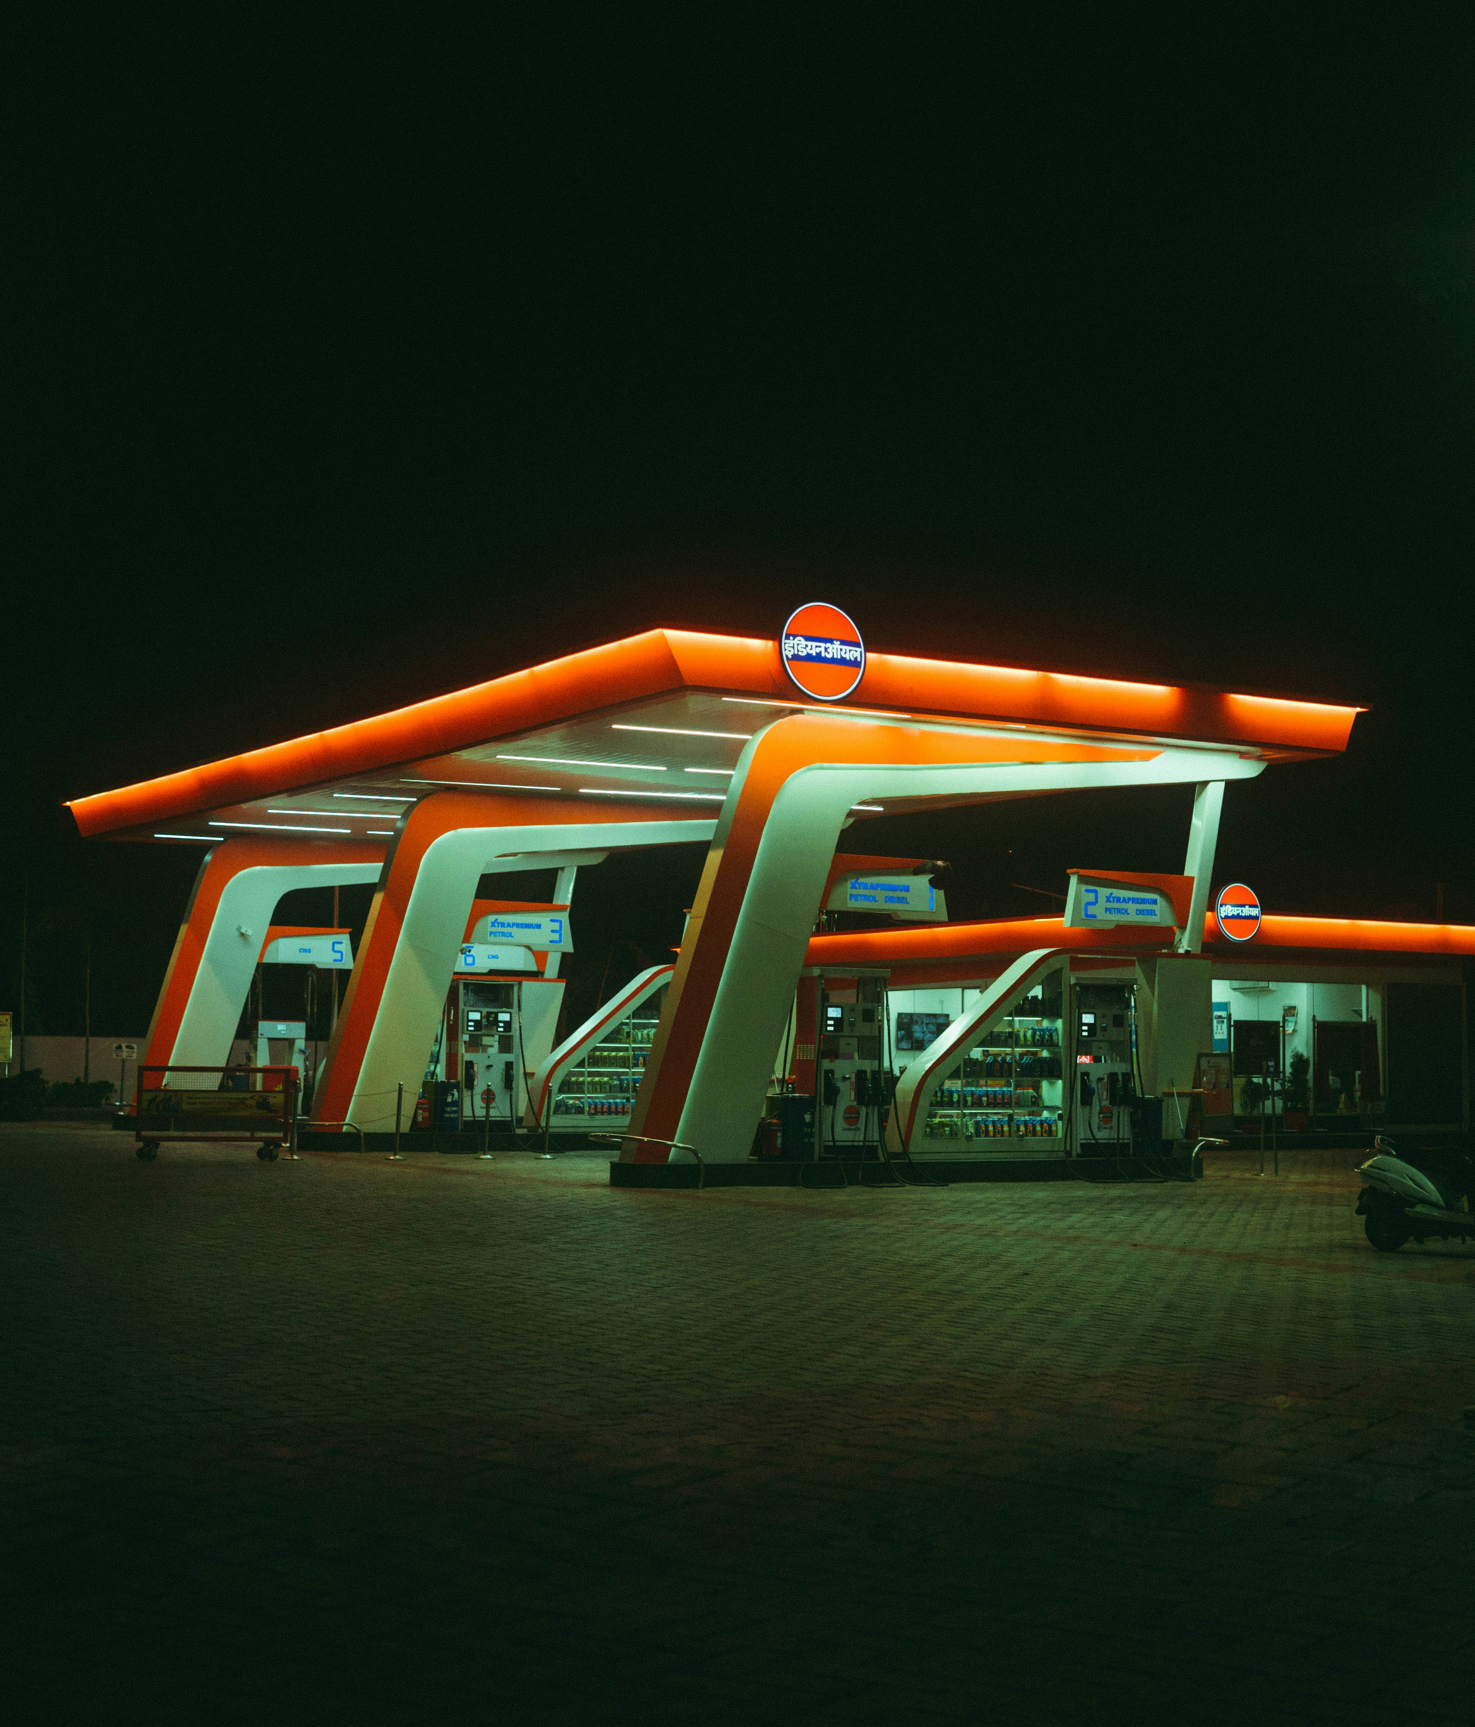
INTRODUCTION
Most automobiles in India run on petrol and diesel. India has a great market for the fuel industry. In August 2023 it was estimated that India uses 4936 thousand barrels per day. As such adulteration of fuel as well and reduction in fuel outﬂow in fuel stations has become a major issue. Our project aims to try and solve some of these issues.

Slide 4
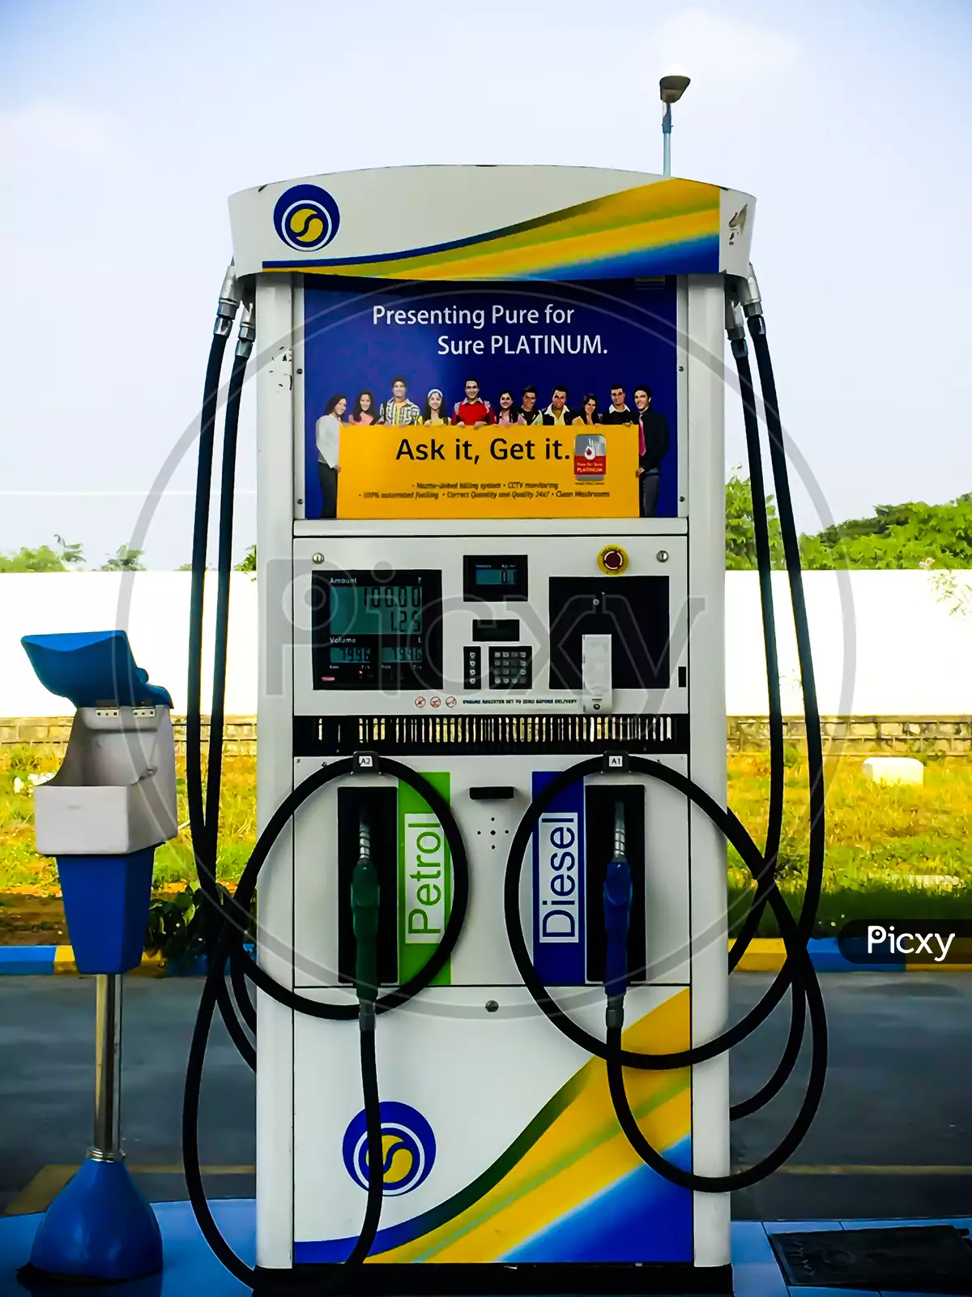
PROBLEM STATEMENT
There has been an escalating number of reports and complaints from customers highlighting the growing problem within the fuel industry-namely, the issue of inconsistent fuel dispensing across various fuel stations.The problem is further exacerbated by concerns regarding the accuracy and quality of dispensed fuel. Scams such as short fueling and tweaking fuel equipment is also a major cause of dissatisfaction and disbelief towards the fuel industry.

Slide 5
OBJECTIVES
To create a unit which can calculate the amount of fuel being poured into the fuel tank for accurate checking of the fuel being dispensed.
To create a unit which can calculate the density of fuel in the fuel tank and show the changes in density when adulterated fuel is added to the fuel tank.

Slide 6
LITERATURE REVIEW
Research Paper | Components / Methods Used | Key Findings / Advancements | Limitations
[1] Determination of Adulteration and Quantity of Gasoline Fuel using IoT Method, IJSET, Feb-2014 | Arduino Uno, Load Cells, TCS3200 Color Sensor, GSM Module | Provides real-time information on fuel quantity and quality; employs an open-source IoT platform; sends data to vehicle owner via SMS. | Limited Sensor accuracy, Inability to read colors in bad lighting.
[2] IoT based fuel quantity measurement, IJRPR, 2020 | Load Cell, GPS, GSM module, Float Sensor | Tracks fuel levels accurately, uploads data to the cloud; incorporates GPS and GSM for fraud prevention by alerting the driver. | Limited Sensor accuracy, reliability

Slide 7
[3] Review on the detection of fuel adulteration through sensor-based techniques, IJSRP, Sept 2017 | Infrared Sensor, Camera, Optical Sensor, Microcontrollers | Comprehensive review of sensor-based techniques for detecting fuel adulteration, addressing both consumer dissatisfaction and pollution. | Difficulty in sensor calibration and getting output for fuel.
[4] Determination of Adulteration and quantity of petrol using pH Meter and Microcontroller, IJIREEICE, May 2019 | pH Electrode, Petro Cards, PIC Microcontroller | pH meter detects adulteration; Petro cards automate petrol bunks; ensures both quality and quantity, with potential for further improvements. | Difficulty in integration of other sensors and higher initial investment
[5] Fuel monitoring on tanks for level detection and purity check, JREAS, April 2019 | Ultrasonic Sensor, IR Rays, Mobile App | Digital display shows exact fuel amount; modules for fuel level, adulteration testing, oil quality check; sends alerts to users via app. | Limited Sensor accuracy

Slide 8
[6] Digitalized flow quantity and adulteration measurement in petrol, IJERT, June 2019 | Turbine Flow Meter, Arduino, Temperature Sensor | Device with a cylindrical cone tipped tank provides accurate readings; small, easy to handle, and requires minimal maintenance. | Bulky system
[7] Detection of fuel adulteration in real time using optical fiber sensor and peripheral interface controller, IJOP Aug 2017 | Fiber Optic Evanescent Wave Sensor, PIC | Real-time detection of adulteration through a fiber optic sensor, interfaced with a PIC for automation and user-friendly display. | Higher sensitivity and difficulty in sensor calibration
[8] Petrol Adulteration Detection System Based On Sensor Technique, IRJMETS, July 2021 | Load Cell, TCS 320 Colour Sensor, Arduino Uno | Achieved an efficiency of 89%; used sensors to compute density and detect color; displayed results on a 16x2 LCD screen. | Prone to external interference and limited accuracy

Slide 9
EXISTING SYSTEM
Fuel systems in vehicles typically use a float assembly connected to a resistor and gauge to measure fuel levels.
The float assembly rises or dips with the fuel level in the tank, changing the resistor value and thus the current sent to the gauge.
Filling stations have both electronic and mechanical components in their dispensers.
The electronic component includes a display, keypad, flow sensors, and a control system
Customers use the keypad to select the desired quantity of fuel.
Flow sensors measure the fuel flow rate as it is dispensed, providing real-time data to the control system.
The control system processes information from the keypad and flow sensors to calculate the amount of fuel dispensed and control the flow rate accordingly.

Slide 10
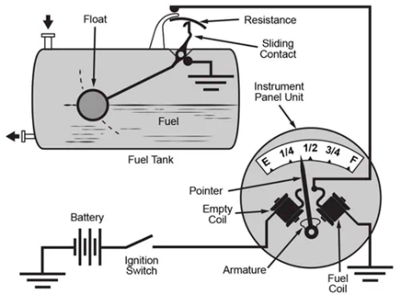
Typical fuel sensing in a tank

Slide 11
EXISTING SYSTEM Determining Quality
Quality of fuel is measured in terms of density at particular temperature
An instrument called Hydrometer used to determine density. It operates based on the Archimedes principle that a solid body displaces its own weight within a liquid in which it floats.
Fuel quality checking at petrol bunks involves using a white filter paper and dropping fuel from the nozzle onto it, then observing for any stains after drying
Density checking involves filling a measuring jar with fuel, immersing a hydrometer, measuring the temperature, and comparing the density with ASTM tables to ensure it falls within acceptable ranges.
PETROL - 720 - 770 kg/m^3
DIESEL - 820- 845 kg/m^3

Slide 12
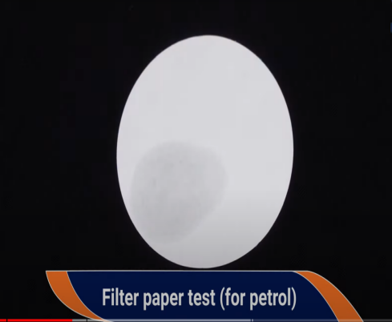
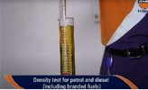
Fuel quality checking in petrol bunks
(Filter paper test)
Density test for petrol/diesel
(Hydrometer test)

Slide 13
FUEL FLOW QUANTITY SETUP
PROPOSED SYSTEM
The proposed system comprises of a flow quantity sensor that is fixed to the end of the funnel. This flow sensor is connected to a microcontroller board and a LCD to display the precise amount of fuel that has been poured into the funnel. The system is totally portable for the consumer so that he can carry it anywhere.

Slide 14
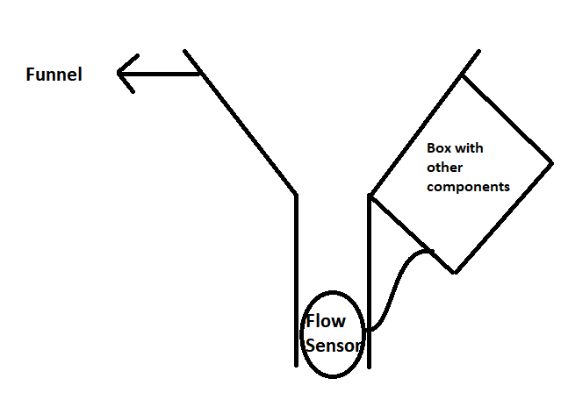
Fig: Proposed setup for flow quantity measurement device

Slide 15
FUEL QUANTITY& QUALITY
The proposed fuel management system incorporates a microcontroller, ultrasonic sensor, and cylindrical tank. The sensor atop the tank continuously tracks fuel levels, while the microcontroller calculates quantity using this data and the tank's radius. To assess fuel quality, a load cell at the tank's bottom measures fuel weight, aiding in density calculation. With density data, the microcontroller references charts at petrol stations to determine fuel purity, streamlining fuel quality management.

Slide 16
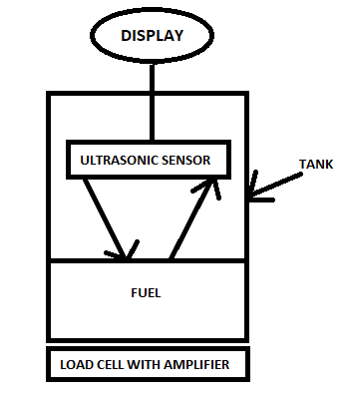
Fig: Proposed setup for Quality and Quantity checking

Slide 17
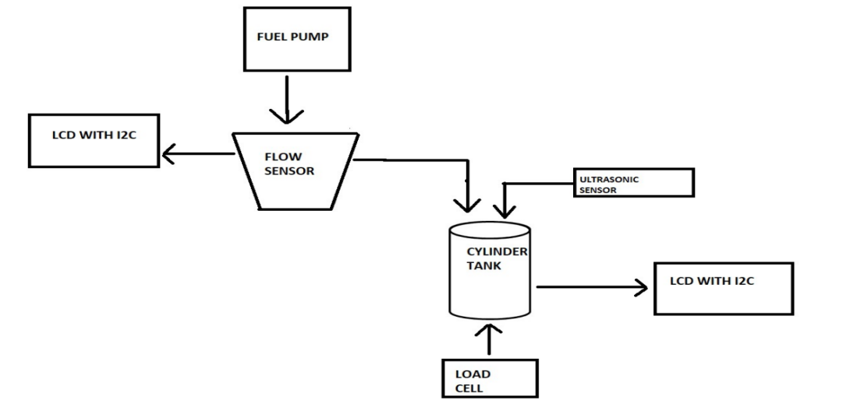
COMPLETE PROPOSED SYSTEM

Slide 18
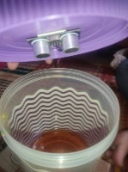
Testing With Ultrasonic Sensor
Issues faced
1. Ultrasonic sensor was not able to read the distance to petrol level accurately
2. Petrol fumes made the adhesive used weak , which caused the ultrasonic sensor to fall down into the container

Slide 19
Need for Alteration
1.Ultrasonic sensor cannot accurately calculate the distance of petrol from the sensor, unlike water petrol is an absorbent of ultrasonic waves that the sensor uses to measure distance.
2.Due to this absorbent nature, utilizing ultrasonic sensors was not possible as it gave inaccurate values of the fuel level in the container.
3. Also, petrol vaporizes easily and these vapors interfere with the computation of distance when using ultrasonic sensor.

Slide 20
OTHER METHODS WE COULD HAVE USED
1. Capacitance sensors
2. Optical sensors
3. Float sensors
4. Pressure sensors
5. Conductive sensors
These were not utilized either because of high costs or high lead times.

Slide 21
DEVELOPED SYSTEM
Fuel Quantity measurement device
We have not made any major changes in the fuel quantity measurement system. The only notable change was adding a switch for switching the system on / off which is connected to a battery for effective power management.

Slide 22
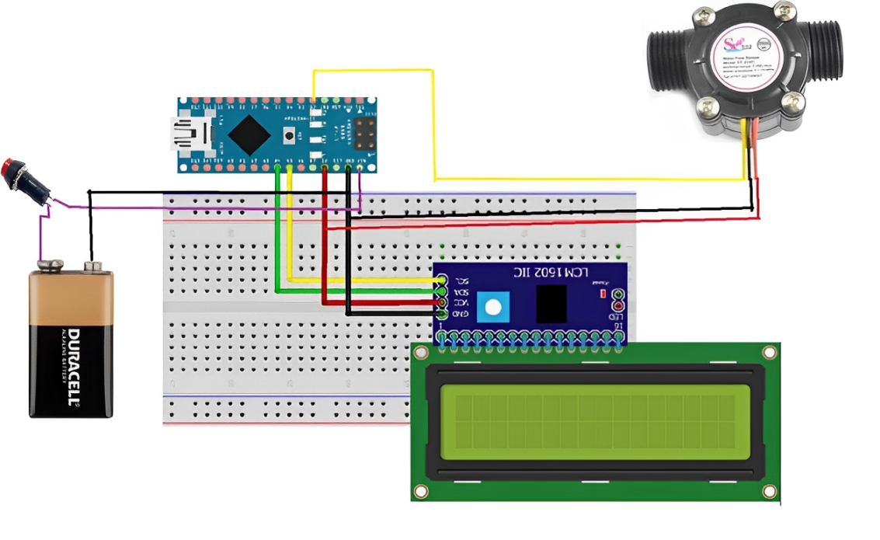
Circuit diagram : Quantity measurement device

Slide 23
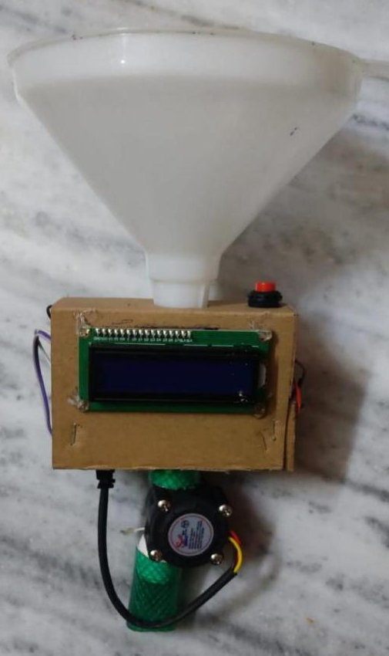
Developed system: Fuel Quantity measurement device

Slide 24
DEVELOPED SYSTEM
Fuel Quality measurement device
Due to ultrasonic sensor not functioning as per our requirements, we removed that from our circuit and added a new button which will update the volume to be calculated for density by 100ml at every press. A buzzer has also been attached which will ring if the density of petrol is in its acceptable range of 720-770kg/m³ . A Battery is also connected to the system for power along with a switch.

Slide 25
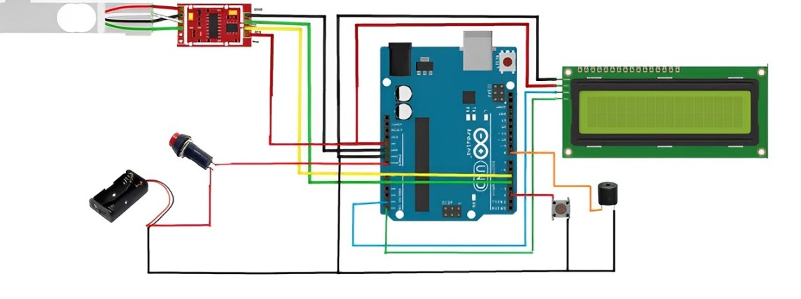
Circuit diagram : Quality measurement device

Slide 26
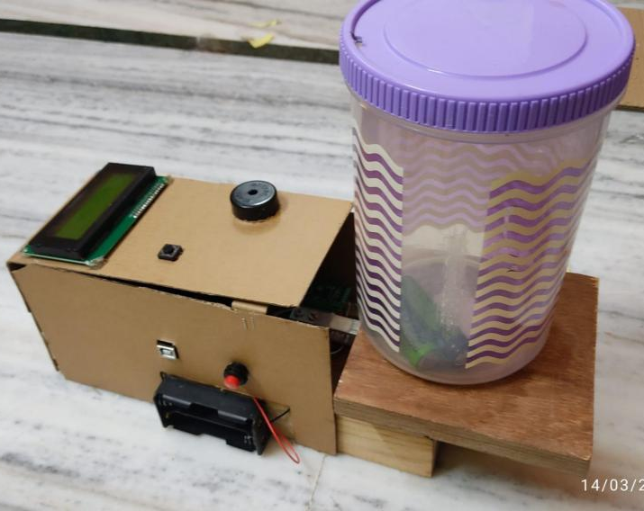
Developed system: Fuel Quality measurement device

Slide 27
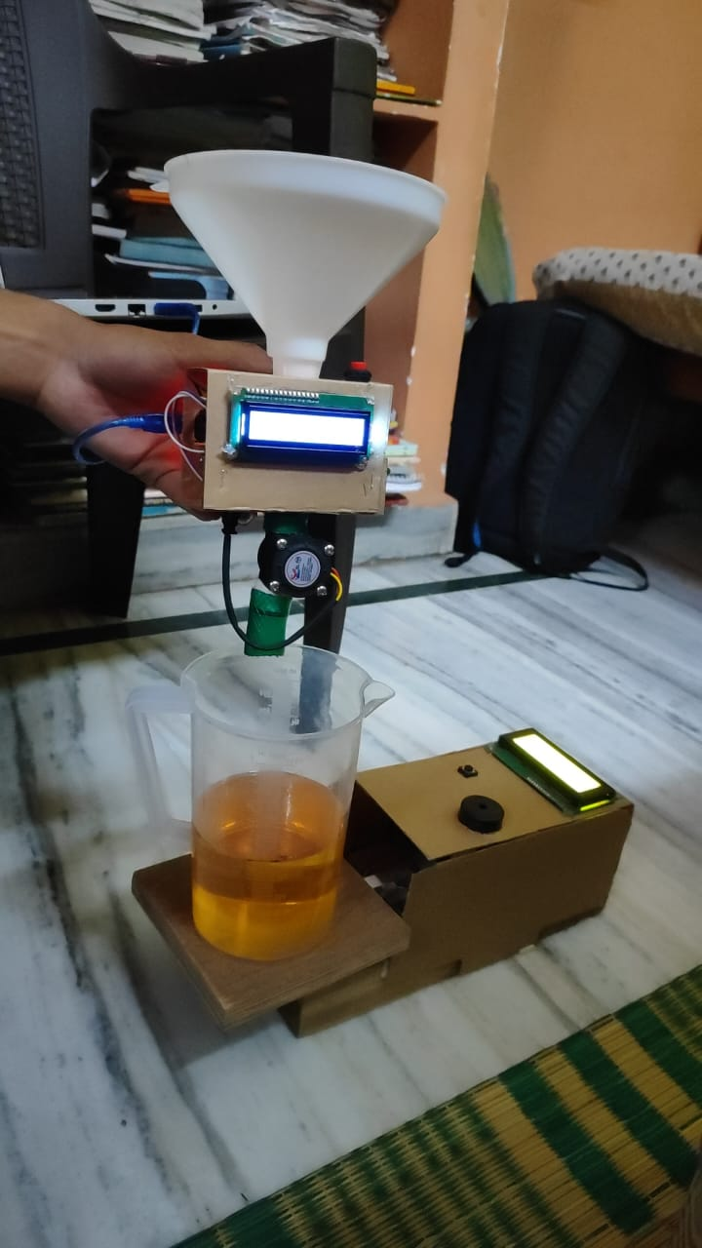
OBSERVATIONS & READINGS
Complete system
( Quality system +
Flow Quantity system )

Slide 28
PETROL READINGS
S.No | Initial Volume (ml) | Poured Volume (ml) | Flow meter Reading (L) | Mass (gm) | Density (g/m³) | Quality of Fuel
1 | 0 | 200 | 0.21L | 151.93 | 0.76 | GOOD
2 | 200 | 200 | 0.41L | 301.72 | 0.75 | GOOD
3 | 400 | 200 | 0.62L | 452.69 | 0.75 | GOOD

Slide 29
Turpentine Oil Readings
S. No | Volume (ml) | Mass (gm) | Density(g/m³)
1 | 0 | 0 | 0
2 | 200 | 157.79 | 0.79
3 | 400 | 319.55 | 0.8
4 | 600 | 480.6 | 0.8

Slide 30
Adulterated Petrol Readings
S.No | Volume of fuel (ml) | Volume of turpentine (ml) | Total Volume (ml) | Mass (gm) | Density (g/m³) | Quality of Fuel
1 | 500 | 200 | 700 | 551.19 | 0.79 | BAD
2 | 500 | 300 | 800 | 631.44 | 0.79 | BAD

Slide 31
CONCLUSION
The goal of this project was to develop a cost effective system that would solve the issues faced by consumers all over the world in regards to the quantity and quality of fuel being provided to the public. The quantity and quality setup developed upon testing gave accurate results demonstrating its effectiveness in improving customer satisfaction by providing them with necessary data when purchasing fuel.

Slide 32
FUTURE ENHANCEMENTS
Implement real-time display of fuel amount and quality in vehicle speedometer.
Include parameters like mileage, tire pressure, engine condition for estimating remaining distance.
Integrate with IoT and Cloud for GPS location of refilled fuel, fuel density, and rating system for stations.
Develop mobile apps for remote monitoring, customizable dashboards, and fuel history.

Slide 33
FUTURE ENHANCEMENTS
Streamline fuel tracking, billing, and reporting for enterprises with fuel tracking devices.
Research and implement advanced sensors for improved accuracy and precision.
Future scope includes innovative solutions driven by evolving technologies and industry needs.

Slide 34
BIBLIOGRAPHY
[1] Determination of Adulteration and Quantity of Gasoline Fuel Using IoT Method 1 Dheeraj Shettigar C, 2 Manikanta R, 3 Veerandar Singh, IJSET.
[2] IOT Based Fuel Quantity Measurement Abhiraj Sutar, Anshu De*, Jaskaran Singh, Dr. Manisha Mhetre, IJRPR.
[3] Review on the Detection of Fuel Adulteration through Sensor based Techniques Bharath LV* and Himanth M, IJSRP.
[4] Determination of Adulteration and Quantity of Petrol using pH Meter and Microcontroller Prof Ms.D.Thaniga1 , Prof G. Gabriel Santhosh Kumar2 , Dr. R. Manivasagam Rajendran3, IJIREEICE.

Slide 35
[5] Fuel Monitoring on tanks for level detection and purity check - A short review, Journal of Research in Engineering and Applied Sciences.
[6] Digitalized Flow Quantity and Adulteration Measurement in Petrol Mr. K. R. Roshan1 , M. Rama Krishnan, IJERT.
[7] Detection of Fuel Adulteration in Real Time Using Optical Fiber Sensor and Peripheral Interface Controller Vivek Padmakarrao Kudea and Anita Patilb , IJOP.
[8] Petrol Adulteration detection system based on sensor technique Isaac C. Febaide*1, Esther E. Odiki*2, IRJMETS.

Slide 36


